Slide 1
The Honor Society for First-Year Academic Success

Slide 2
Congratulations on your academic achievement!
You have met the GPA criteria of 3.5 or higher for membership in Alpha Lambda Delta Honor Society. Joining can open doors for you and offer opportunities to stand out, be recognized, connect with a supportive community of peers, and enjoy a more well-rounded college experience.
We want to tell you more about our chapter here at {name of institution} and answer any questions you may have.

Slide 3
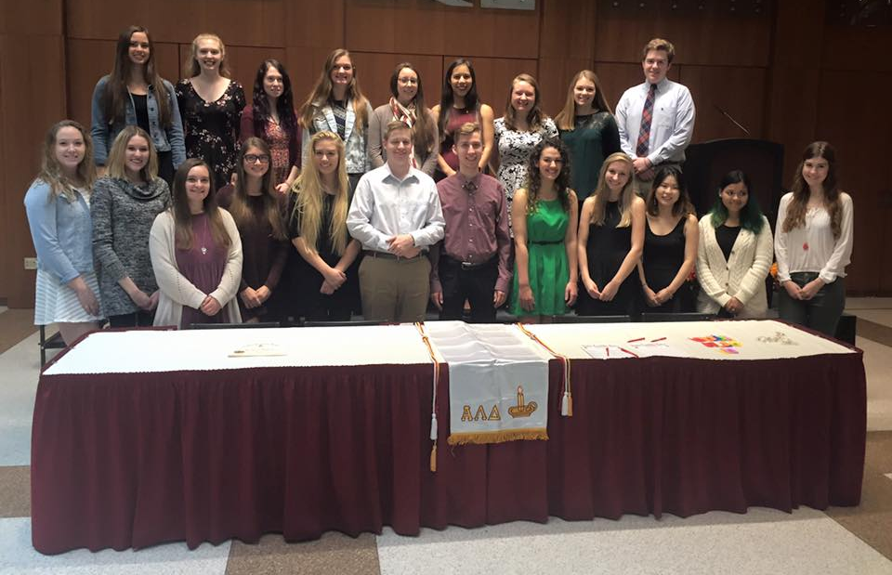
What we do on campus
Add slides with pictures of induction ceremonies, service projects, campus activities, etc.
Notes:
Talk more about the benefits you’ve enjoyed by being involved – what have you gotten out of it
Share pictures of past activities

Slide 4
Notes:
Tell students what they get out of membership. TELL YOUR STORY – have officers and general student members share why they joined and what they’ve gained.

Slide 5
Alpha Lambda Delta
offers exclusive membership benefits
to help you stand out,
be recognized,
and enjoy a more well-rounded
college experience.
Notes:
https://www.nationalald.org/benefits

Slide 6
Notes:
https://www.nationalald.org/benefits

Slide 7
Benefits of Your Membership
As soon as you become a member, you’re eligible for:
Scholarships: https://www.nationalald.org/scholarships
Perks: https://www.nationalald.org/aldperks
ALD Leads: https://www.nationalald.org/leadscertified
Notes:
Scholarships: 96 scholarships offered annually, ranging from $1000 to $6500, for undergraduate, graduate, and study abroad
Perks: Discounts and perks from over 300,000 companies
ALD Leads: Leadership and career development certificate series; online, self-paced

Slide 8
Benefits of Your Membership
Career Conversations: https://www.nationalald.org/career
Educational Partners: https://www.nationalald.org/partners
Wear Honor Cords at Graduation: https://www.shopald.org/
Notes:
Career Conversations: profiling different majors and academic disciplines culminating with an interview with a successful alum in that field
Ed Partners: test prep discounts, internship scholarships, job matching, and more
Cords: wear honor cords and other regalia at your commencement ceremony

Slide 9
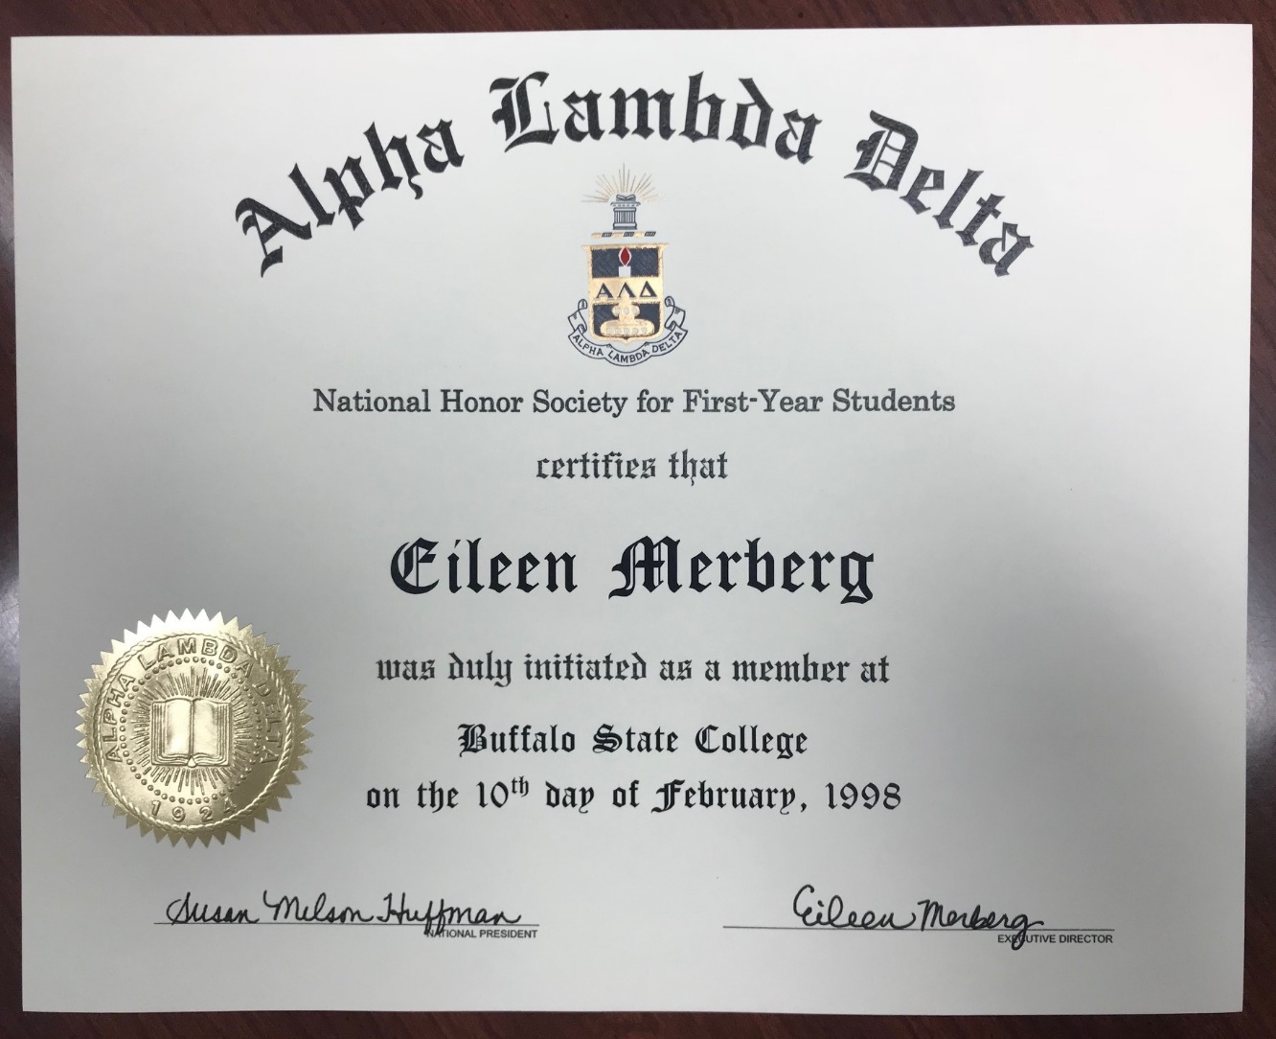
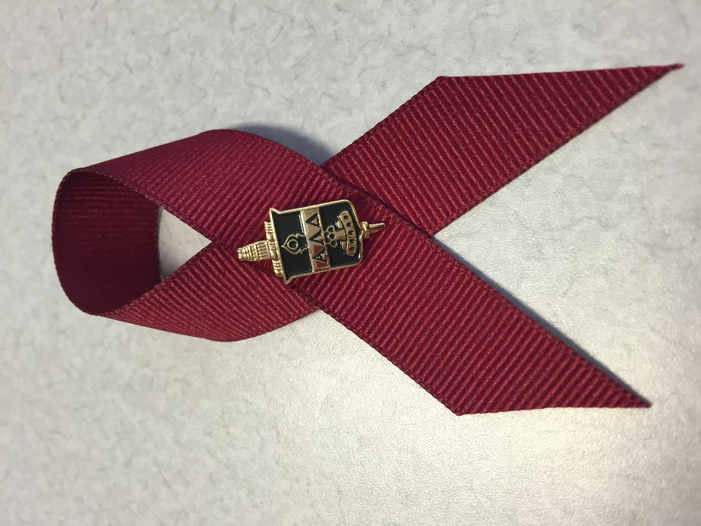
Notes:
Describe what happens once they join – that they are inducted during a ceremony – show pictures of past ceremonies
Each student receives a certificate and pin

Slide 10
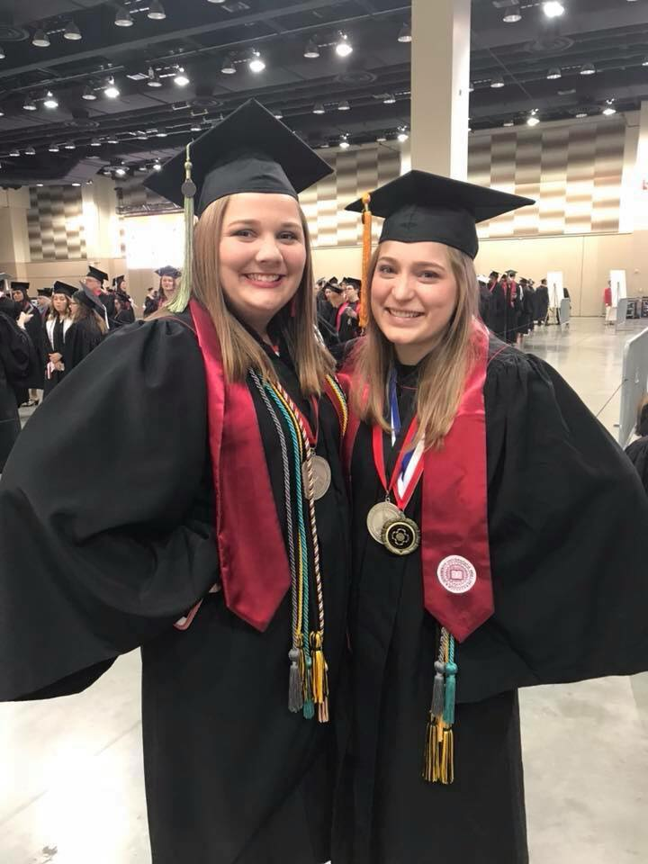
Notes:
All members can wear the ALD Honor Cord at graduation

Slide 11
Talk about the ALD membership fee.
A lot of groups students get invited to join charge hefty fees, between $80-$100 minimum – and some charge additional fees throughout college. ALD’s $30 national fee is the lowest of any honor society in the US. Mention the added local fee, still low compared to other groups.
Assure students there are no hidden fees
and the ALD fee is onetime, lifetime.

Slide 12
The invitation to join Alpha Lambda Delta may not be the only honor society invitation you’ll receive. You may be wondering which honor organizations are legitimate and which ones might be scams or only after your money. Alpha Lambda Delta is accredited with the Association of College Honor Societies, the nation’s only certifying agency for college and university honor societies. ACHS sets standards for organizational excellence and for scholastic eligibility, so you can be assured that Alpha Lambda Delta is a credible organization.
We have been active at {institution} since {year-founded}!
Notes:
https://www.achshonor.org/is-this-invitation-legit-

Slide 13
Why Join ALD video
Notes:
Show the “Why Join” video on our website
https://youtu.be/HOoJGBmsyo4

Slide 14
Follow us
@nationalALD

