Slide 1
Alpha Lambda Delta
DEIB Training
Notes:
Diversity, Equity, Inclusion, and Belonging (DEIB)

Slide 2
What is DEIB?
DEIB stands for diversity, equity, inclusion and belonging.
Diversity is the practice of including or involving people from a range of different social and ethnic backgrounds and of different genders.
Equity is the quality of being fair and impartial.
Inclusion is the practice or policy of providing equal access to opportunities and resources for people who might otherwise be excluded or marginalized.
Belonging is the need for a close relationship within a group and a desire to be a part of something greater than oneself.

Slide 3
Why is DEIB Important?
DEIB plays an important role in all aspects of a person’s life.
DEIB is a lifelong commitment of educating oneself and others.
DEIB helps to foster well-rounded individuals who can achieve more through working together because everyone brings a unique perspective and skill set to the table.

Slide 4
Activity One: Diversity
Split into 3 different groups based on what you would identify as the best description of the place you grew up in.
Group 1: The City
Group 2: The Country
Group 3: The Suburbs
Discuss within your group how your experience was unique to your location:
What differences did you notice within your group?
What similarities did you notice within your group?
You will have a spokesperson from each group share with all of those in attendance.
Notes:
Offer around 5 minutes for individual group discussion and allot more time if needed.

Slide 5
Share What You Noticed
What differences did you notice between all three groups?
What similarities did you notice between all three groups?
Many times, no matter how different we might think we are,
we have a lot more in common than we realize.
Notes:
Highlight specifically similarities between the people from each area and what they encounter/what problems they face. E.g. there are nice people from all three areas.

Slide 6
Activity Two: Equity
Observe the graphic to the right.
Why do you think the first set of images represents equality?
Why do you think the second set of images represents equity?
Notes:
Ask for volunteers to share their thoughts with the group.

Slide 7
Equality Vs. Equity
Equality is giving everyone the exact same resources.
Equity involves distributing resources based on the needs of the recipients.
We all come from different backgrounds and therefore we might not always need the exact same resources to be successful. Some people might need more, less, or different resources than others to achieve their goals.
https://www.mentalfloss.com/article/625404/equity-vs-equality-what-is-the-difference
Notes:
Use the previous slide graphic to highlight why each set of images represents either equality or equity based on the now known definitions.

Slide 8
Activity Two
Discuss what you think the difference is between equality vs. equity?
Can you think of examples of equality and equity in your life?
Notes:
Ask for volunteers to share their thoughts with the group.

Slide 9
Activity Three: Inclusion
Have you ever felt like you don’t belong or you’re not good enough despite all evidence to the contrary?
(Think about this personally and share only if you are comfortable with sharing.)
Notes:
Offer for volunteers to share with the group as a whole, but remind them that they do not have to share if they are not comfortable sharing.

Slide 10
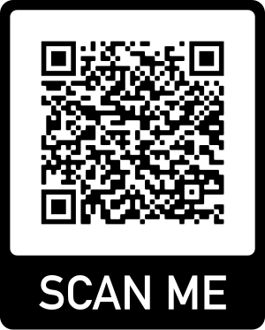
Imposter Syndrome
Imposter syndrome involves feelings of self-doubt and personal incompetence that persist despite a person’s education, experience and accomplishments. If not addressed, these feelings can lead to mental health issues.
(Click on the link or scan the QR code to view an article by the Cleveland Clinic that provides tips for overcoming imposter syndrome.)
https://health.clevelandclinic.org/a-psychologist-explains-how-to-deal-with-imposter-syndrome/

Slide 11
Neurodiversity and Communication

Slide 12
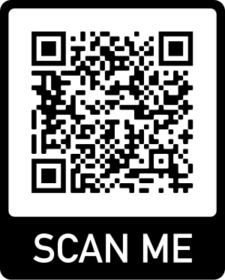
Neurodiversity
Neurodiversity refers to variation in the human brain regarding sociability, learning, attention, mood, and other mental functions.
Neurodiversity supports the idea that people experience and interact with the world in many different ways.
Differences should not be viewed as deficits.
(Click on the link or scan the QR code to view an article by Harvard Health that describes neurodiversity more in depth and ways to make spaces more neurodiversity-friendly.)
https://www.health.harvard.edu/blog/what-is-neurodiversity-202111232645
https://en.wikipedia.org/wiki/Neurodiversity

Slide 13
Communication
Every day you have the opportunity to communicate with people who have unique backgrounds.
Things to keep in mind.
Consider the sensitivity of words and phrases that relate to culture, race, gender, etc.
Recognize and respect that other people have unique points of view and experiences based on their background.
https://www.forbes.com/sites/forbescommunicationscouncil/2020/10/21/a-guide-to-diversity-equity-and-inclusion-in-communications/?sh=69a7b0a82b54
Notes:
Every day that you communicate with someone, you are incorporating DEIB because every person is unique in their own way. No two people are exactly the same as each other.

Slide 14
Ideas to Think About

Slide 15
DEIB is Not a Destination
We should all set a goal to be a lifelong learner for the betterment of society. This also holds true for DEIB. There is never a point when we are finished with DEIB. It is not an item on a list that is checked off. Rather, it is a lifelong goal to commit to every day that helps to create a positive and more inclusive society.
https://hiringsuccess.com/4-lenses-for-ta-leaders-that-will-change-how-you-view-deib/
Notes:
Remember that diversity is not defined as one group of people. Everyone coming together from unique backgrounds and with different values is what creates diversity.

Slide 16
How to Apply DEIB in Your Chapter
Actions speak louder than words.
Be sure to promote DEIB not only through your dialogue, but most importantly through your actions.
Celebrate important cultural days, months, and events.
Promote diversity within member recruitment.
Commit to continuing education on DEIB for new and returning members.

Slide 17
Takeaway
“Life’s most persistent and urgent question is, 'What are you doing for others?'” - Martin Luther King Jr.
Notes:
Make it a goal to help others in every way that you can.

Slide 18
Want More Information?
Check out the Thursday’s Theme Posts along with other resources on the Alpha Lambda Delta national website and instagram page.
https://www.nationalald.org/deib
Notes:
Ask for questions from the audience pertaining to the presentation.

