Slide 1
Alpha Lambda Delta
The National Honor Society for First-Year Success
Induction of New Members
{Name of Institution}
{Date}

Slide 2
Introductions
Induction of Members
Installation of Chapter Officers
National Council Welcome
Chapter Benefits
Closing
Notes:
The following slides should be read in full. Start with reading content of slide, then content of Notes section.

Slide 3
Alpha Lambda Delta is a national society which honors high academic achievement in the first year of college.
Notes:
The purpose of the organization is to encourage superior academic achievement among students in their first year in institutions of higher education, to promote intelligent living and a continued high standard of learning, and to assist students in recognizing and developing meaningful goals for their roles in society.

Slide 4
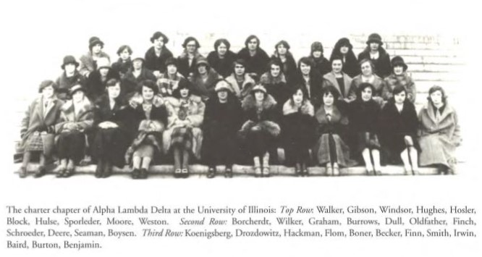
Alpha Lambda Delta was founded as an honor society in 1924 at the University of Illinois by the Dean of Women, Maria Leonard.
Notes:
It soon became a national organization as chapters were established at Purdue University in 1926 and at DePauw University in 1927. Growth of the society has continued with almost 400 chapters recognized.
(Maria is pronounced Mar EYE ah)

Slide 5
These candidates who are now presented for induction have attained the high standard required by National Alpha Lambda Delta and are worthy to be recognized by both their college and this organization for their notable achievement in scholarship.

Slide 6
We are here to inform the new inductees concerning our organization and to ask them to take the pledge to make the best possible use of your education.
The initials of our name stand for the Greek words: Allelois Lampadia Diadusousin which stands for the motto “we shall pass our torches on, one to another.”
Notes:
Allelois Lampadia Diadusousin is pronounced: al-LAY-loy Lam-PAH-dee-uh dee-uh-DOH-suh-sin

Slide 7
Notes:
The insignia of Alpha Lambda Delta represents a lighted candle. The golden base of our candle signifies honesty and integrity, which are the foundation on which we build; the shaft of our candle signifies strength and courage; and the light of our candle signifies truth and wisdom -- which can dispel ignorance and superstition, and give us the insight to live well in our time.

Slide 8
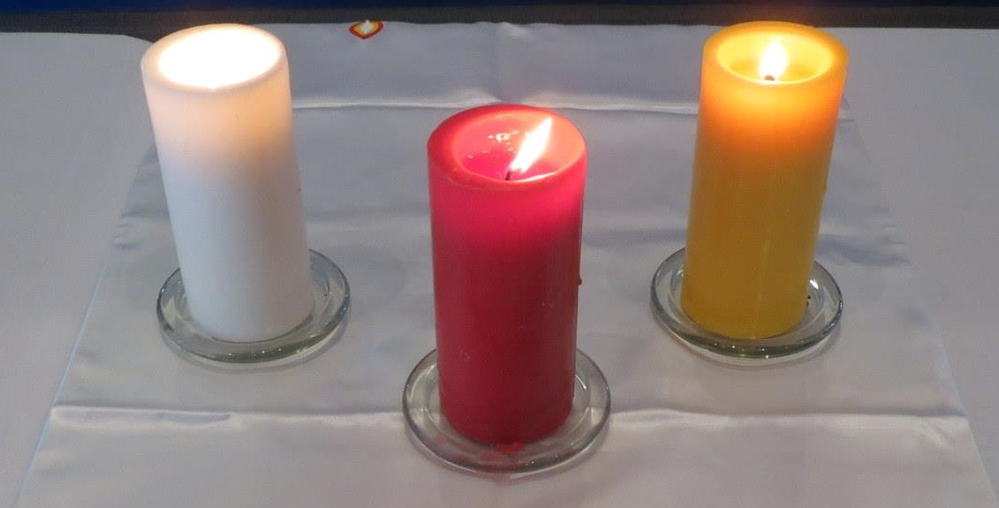
The red represents the burning flame of knowledge.
The white represents the search for truth.
The gold represents the strong base of honor.
Notes:
These, our three colors, symbolize the standards held by members of Alpha Lambda Delta.

Slide 9
Your education is the means by which you learn to recognize the wonders of science, to appreciate the beauty of great literature and art, to use well your own language,
to learn the lessons of past history,
to speak and read the languages of
others, to study the social and political
forces of our world, and to discuss the
thought and the philosophy
of other ages.
Notes:
Through these means you can evaluate the forces and standards of your generation and learn to live significantly.

Slide 10
Induction of Members
We now wish to induct individually the students who have earned the privilege of becoming members of the {Insert name of institution here} chapter of Alpha Lambda Delta.
We’ll start with all reciting the Pledge. Wherever you are, repeat after me:

Slide 11
The Pledge
I accept membership . . .
Into National Alpha Lambda Delta . . .
Understanding that in doing so . . .
I assume the responsibility. . .
Of continuing to maintain . . .
Its standards of service . . .
Of diligence....
And of integrity.
I pledge to promote high scholarship. . .
And to use my education . . .
For the benefit of my community . . .
My nation . . .
And the world in which we live.

Slide 12
Inductees
We’ll now share all the names of inductees.
When you see your name please type in the Chat box your response to the Pledge by saying: “I accept”

Slide 13
Inductees
{Insert Inductee Names}

Slide 14
You have now recorded your induction into the [name of institution] chapter of Alpha Lambda Delta on [the day of the month, the month, year].
Notes:
May you find in the years ahead the rewards of the educated person - imagination, adventure, humor, compassion and understanding. May you have tolerance in your dealings with all persons, generosity in giving to those in need, and insight into the feelings of others. In relating your education to the world in which you live, you can make a meaningful contribution to society.

Slide 15
A Welcome from the National Organization
Notes:
Show 4-minute video:
https://youtu.be/R2_2Hc-jY-M

Slide 16
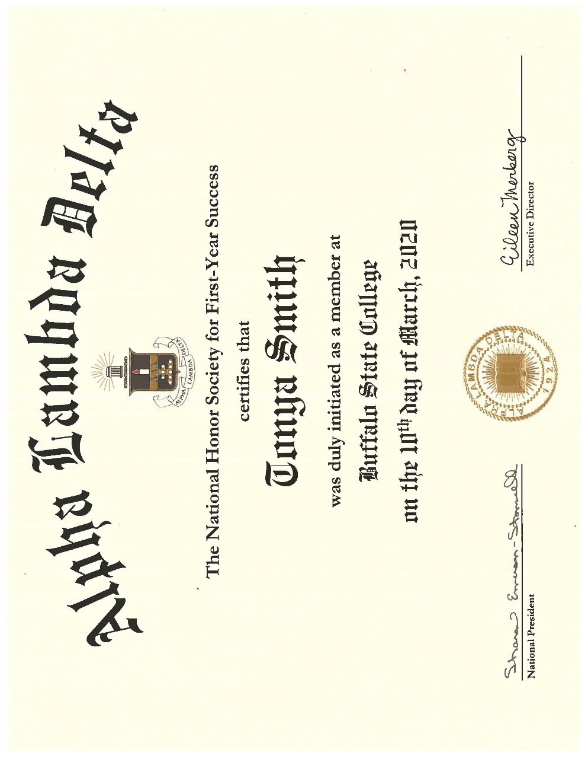
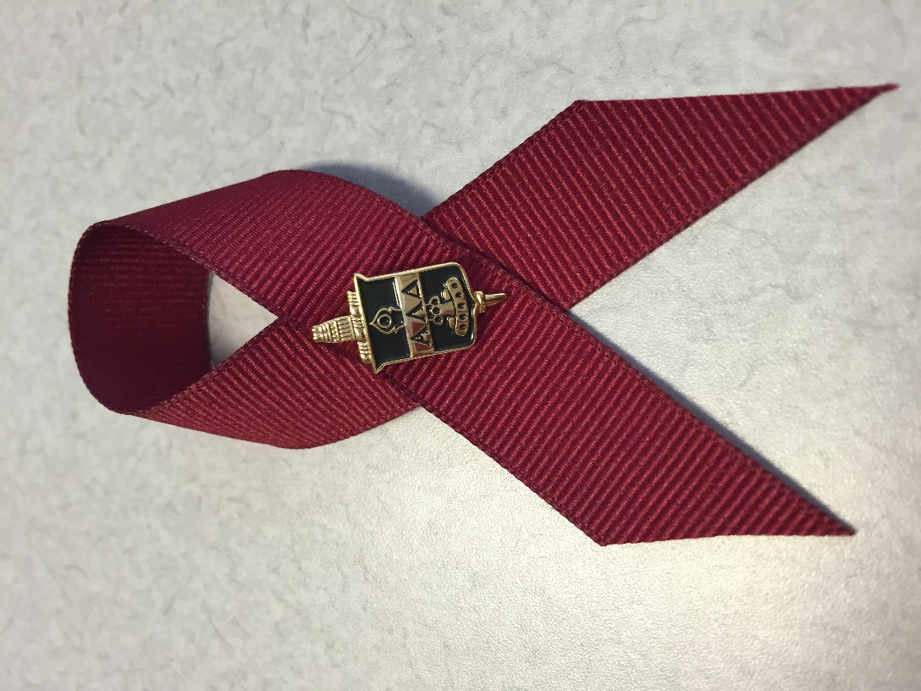
Notes:
Explain how students will receive their membership certificate and pin

Slide 17
Benefits of Your Membership
Now that you are a member, you’re eligible for:
Scholarships: https://www.nationalald.org/scholarships
Perks: https://www.nationalald.org/aldperks
ALD Leads Certified: https://www.nationalald.org/leadscertified
Notes:
Pull up a few ALD web pages and briefly review:
Scholarships: 96 scholarships offered annually, ranging from $1000 to $6500, for undergraduate, graduate, and study abroad
Perks: Discounts and perks from over 300,000 companies
ALD Leads Certified: Leadership certificate sereis

Slide 18
Benefits of Your Membership
Career Conversations: https://www.nationalald.org/career
Educational Partners: https://www.nationalald.org/partners
Wear Honor Cords at Graduation: https://www.shopald.org/
Notes:
Career Conversations: online chats with alumni successful in their field
Ed Partners: test prep discounts, internship scholarships, job matching, and more
Cords: get ALD swag; wear honor cords and other regalia at your commencement ceremony

Slide 19
Follow us
@nationalALD
Notes:
Eileen

Slide 20
What Our Chapter Does
{Create a few slides here outlining chapter programs, how they can get involved, etc.}
Include pictures of service projects, campus activities, etc.

Slide 21
Thank you for attending the ALD Induction Ceremony.
All the best to our New Members!
Alpha Lambda Delta
The National Honor Society for First-Year Success

