Slide 1
Avoiding The Ambitious Person’s Mistake
ADVENTURE
SPEAKER
CHARLES
SCOTT
Notes:
Around 6 million years ago the Colorado River began carving the Grand Canyon, eventually exposing sediment layers nearly 2 billion years old. Every year of work, the Colorado revealed 333 years of sediment. The GC is a metaphor for the dramatic results that are possible with steady, consistent effort.
Facts: GC is 277 miles long, 18 miles wide and 1 mile deep.

Slide 2
I’m Not Your Typical Business Presenter
EXAMINE
APPLY
CHALLENGE
Notes:
I want you to examine your personal and professional decisions. Apply philosophical and psychological concepts to your professional life. I will encourage you to challenge your perceived limits.

Slide 3
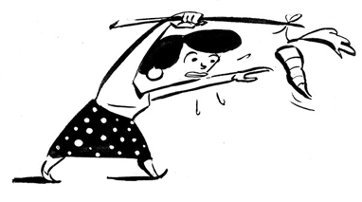
Growth and Learning
Perceived
Limit
Actual
Limit
Your capabilities

Slide 4
What Are Your Perceived Limits?
Can’t lose weight
Not enough time
Can’t find true love
Too busy to focus on self-care

Slide 5
Squaw Peak

Slide 6
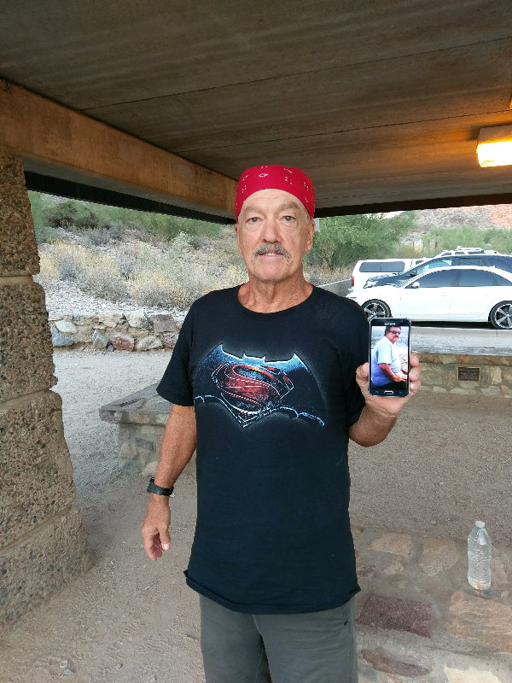
Lee Thomason
Age: 61
Weight: 160 lbs
Weight 14 months ago:
240 lbs

Slide 7
My Mission
Help you think about why you do what you do
and
Help you add passion and drive to your life
Notes:
Think about what happens after you hear a speaker. You take notes, reflect on whether and how the content is applicable to your life, and then you move on. If the speaker is good, you might talk about the content that night at home with your spouse. You might even wake up the next day, thinking about an anecdote or key lesson that was particularly meaningful or relevant to you, and perhaps you try to implement it that day. A week passes, and many of the details from the talk will likely fade from memory. Eventually, you’ll be left with an emotion – “He told some cool stories,” or “He made me feel like coming up with my own adventure.” But life takes over and you move on. Knowing this will happen, many CEOs have approached me after my talks to ask how to implement these principles into their daily lives in a way that sticks. I’ve worked with a number of CEOs 1:1. Here are some common issues I’ve encountered.

Slide 8
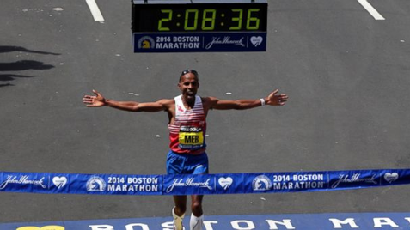
Meb Keflezighi
Only person to win an Olympic medal, the NYC Marathon and the Boston Marathon
Won the 2014 Boston Marathon at age 38 (oldest men’s champion since 1931)
Key to winning Boston 2014:
- “Allow adequate recovery between hard sessions”
- “It’s all about staying healthy”
Notes:
Hometown: Keflezighi was born in Eritrea, but immigrated to San Diego, Calif., with his family when he was 12.
Greatest Running Achievements: Keflezighi can add winning Boston Marathon to his long list of achievements, which also include winning a silver medal (Marathon) at the summer Olympics in Athens in 2004 and winning the New York City Marathon in 2009.
He’s One of the Oldest Champions: Keflezighi turns 39 next month and is the oldest men’s champion in Boston since 1931. James P. Henigan was 38 when he won the 35th version of the race that year and turned 39 five days later on April 25, 1931.
The year before that, 1930, Clarence H. DeMar won the race with a time of 2:34:48 at age 41. It was the last of LeMar’s seven Boston wins.

Slide 9
Meb’s View of Recovery
“Recovery is the glue that holds all the elements of your running program together. Without it, you won’t get the full benefits of the hard work you do.”
“A lot of runners don’t realize that it’s not while you’re running that you get in better shape.”
“Being as dedicated to your recovery as you are to your harder workouts will allow you to perform at your max.”
* Quotes taken from the book Meb for Mortals by Meb Keflezighi and Scott Douglas

Slide 10
Rookie Runner Mistake
Training hard all the time
Meb Keflezighi:
“One of the biggest differences between the training of world-class runners and that of recreational runners is how slowly we elites sometimes run.”
* Meb for Mortals by Meb Keflezighi and Scott Douglas

Slide 11
The Secret to Optimal Performance:
Treat recovery with the same respect
As the hard work

Slide 12
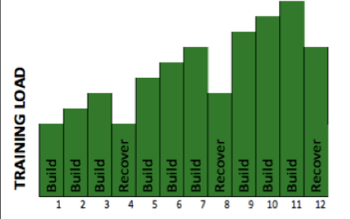
The Concept of Periodization
Periodization:
Strategic implementation of specific training phases to greatly improve performance
Pros know the secret of periodized training and supercompensation
Principle of stress-recovery-adaption
Stress + Rest = Growth
“There is no such thing as overtraining. Just under-recovery.”*
“Avoiding overtraining is probably the most important key there is to attaining athletic excellence.”**
* Fitness Coach Mike Burgener
** Nutrition and Health Magazine
Notes:
Homeostasis is our current ability to perform. Periodization utilizes the principles of stimulus, fatigue, recovery, and supercompensation to create a cyclical (not straight line) pathway to long term improvement of our homeostasis. Each time you work out, a stimulus (stress) is placed on the body. This causes fatigue (breakdown), and the body is forced to respond. The body's response is known as recovery. Recovery leads to supercompensation, which is essentially a limited period of time where our homeostasis is nudged up a notch. Rinse and repeat.

Slide 13
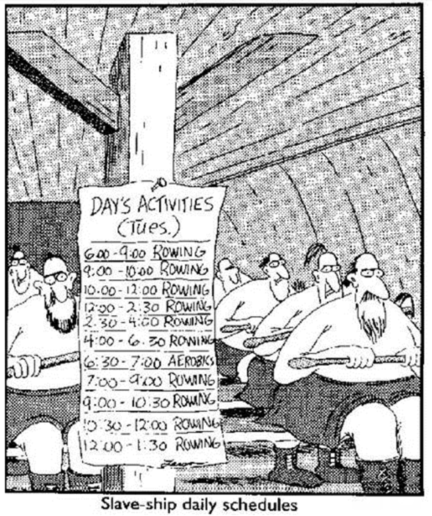
Periodization makes obvious sense for athletes
But is it relevant to your life?

Slide 14
Other Examples of Periodization
Attending this workshop!
Don’t multi-task. Single-task: do one thing at a time with deep concentration
Work in 60 – 90 min spurts with 15-minute breaks
Meditation
“Mindful Work” by David Gelles www.headspace.com
Regular exercise
Link between regular exercise during the work day and increased productivity, better time management, and improved mental sharpness*
* In studies by the American College of Occupational and Environmental Medicine and University of Bristol, for example
Notes:
Recommend the book “Mindful Work” by David Gelles, and www.headspace.com
Study finds link between time off work for exercise and increased productivity
Taking time out of the work week for an employee exercise program may lead to increased productivity –despite the reduction in work hours, reports a study in the August Journal of Occupational and Environmental Medicine, official publication of the American College of Occupational and Environmental Medicine (ACOEM).
In the study, one group of employees at a large Swedish public dental health organization was assigned to a mandatory exercise program carried out during regular work hours: 2 1/2 hours per week. Another group received the same reduction in work hours, but no exercise program. (A third group worked regular hours with no exercise program.) The researchers were Ulrica von Thiele Schwarz, Ph.D., and Henna Hasson, Ph.D., of Karolinska Institute, Stockholm. Employees assigned to the exercise program also had significant increases in self-rated measures of productivity: they felt more productive while on the job and had a reduced rate of work absences due to illness.
The results suggest that reducing work hours for exercise or other health promotion doesn’t necessarily lead to decreased productivity –and may even lead to increased productivity. The productivity gains seem to result from higher output during work hours and fewer missed work day. Drs. von Thiele Schwarz and Hasson conclude, “Work hours may be used for health promotion activities with sustained or improved production levels, since the same, or higher, production level can be achieved with lesser resources.”
See more at: http://www.employmentlawdaily.com/index.php/news/study-finds-link-between-time-off-work-for-exercise-and-increased-productivity/#sthash.rZ5GXn7E.dpuf
Exercise during the workday improves job performance, British research has shown. A study by Jim McKenna from the University of Bristol showed that after exercising, participants returned to work more tolerant of themselves and more forgiving of their colleagues. Their work performance was also consistently higher, as shown by better time management and improved mental sharpness.
Researchers expected that midday exercise would enhance mood. But the boosts in productivity surprised them, proving that workplace exercise programs benefit more than just the workers—they give companies more efficient employees who work better together. Health care costs can be expected to go down for employees who exercise regularly at work, resulting in fewer sick days, better attendance and more cooperation between co-workers.
Action Sparked
If your employer offers onsite exercise facilities, start using them as often as you can. If you don’t have a gym at your office, join a local fitness club. See if your employer will help pay your membership fees—many clubs offer discounts to co-workers who join together. At the very least, bring along your walking shoes and take a heart-pumping walk instead of going out for a high-calorie lunch. After all, taking time to exercise could translate into higher pay if your job performance improves as a result.

Slide 15
To Do lists are great But how about…

Slide 16
Make A List of To Don’ts
What patterns do you want to change?
What negative behaviors can you modify?
Optimal Performance requires discipline in
what you do and don’t do

Slide 17
Periodize Your Day
Wake up, ideally after 7+ hours of sleep. Do not check your phone!
Meditate for 10+ min
Take 20-minute walk (maybe include friend, family member or pet)
Shower, get dressed
Before checking texts/social media, write out the day’s schedule and To Do list
After lunch, take a nap!

Slide 18
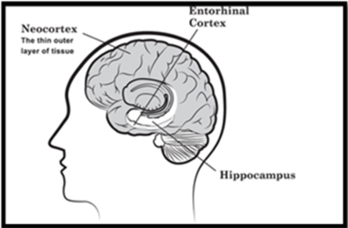
The Value of Napping
Help you learn new information
(hippocampus to the neocortex)
Make you more productive
Can give you a jolt of creativity
Make you more pleasant to be around:
Naps elevate your mood like a cup of coffee
The Week.com “Four Research-Backed Reasons You Should be Allowed to Nap at Work”
Notes:
Labeled in the figure are three areas. The entorhinal cortex acts as filter for the incoming information, the hippocampus is the area where memory formation begins and neocortex is the area where conscious memories are stored. It was H.M, the legendary case study that helped medical research community and doctors give a first glance in to the workings of the brain. Doctors removed hippocampus from H.M’s brain essentially removing the ability to form long term memories. Many amazing aspects of brain were revealed by conducting experiments on H.M. One of them being motor skills like playing music, driving a car are not dependent on hippocampus. This meant that memories were not uniformly distributed and brain had specific areas that handled different types of memory. H.M had some memories of his past after removal of hippocampus. This means that there were long term memories residing in some part of the brain. The researchers then figured out that the only candidate left in the brain where memories could be stored was the neocortex. The neocortex is the seat of human consciousness, an intricate quilt of tissue in which each patch has a specialized purpose.
This article summarizes several research studies about the value of napping:
http://theweek.com/articles/461630/4-researchbacked-reasons-should-allowed-nap-work
Be honest: That burrito you scarfed down for lunch probably wasn't the best idea in the world. And now, you have what Dave Chappelle warmly calls "the itis." Your eyes can't stay open and your productivity is shot, but a warm, cozy nap eludes you. It's not just you, though! Take heart knowing that when it comes to recharging your brain power, science is actually on your side. Here, in no particular order, are four lab-tested reasons you should be allowed to take an afternoon snooze while on the clock:
1. Naps help you learn new information You spent all morning trying to learn about a potential new client, but nothing's sticking. What to do? German researchers suggest a quick siesta.
Psychologists have long known that fresh memories get stored temporarily in the hippocampus, aka the brain's "loading dock." Sleep helps transport this information to the brain's more permanent storage area in the neocortex. Researchers from the University of Lubeck in Germany decided to test this by asking volunteers to study an assortment of pictures, poems, and algebra equations. Participants who took a 40-minute nap after combing through the material ended up performing up to 85 percent better on a memory test than their non-napping peers.
2. Naps makes you more productive Look, you're supposed to get a full eight hours of sleep every night, but let's be real: Nobody has time for that. That's why companies like Nike and Deloitte are embracing what Cornell psychologist James Maas dubbed the power nap.
Sleep deprivation does all sorts of icky stuff to your body, like causing insulin levels to spike and significantly raising your risk of heart disease. A power nap — 30 minutes or shorter, or before you enter REM sleep — can help you make up for lost time, especially if you work long hours. A 20-minute nap between 1 p.m. and 3 p.m. after lunch "will allow you to be as productive right after the nap as you were before it," according to Bloomberg Businessweek.
And if your workplace isn't equipped for napping, try your car. Just remember to set an alarm.
Sleep Deprivation in America | Infographics
3. Naps can give you a jolt of creativity If you've spent all morning stumped by a logistical problem, a power nap can give your brain the creative firepower it needs to find the solution. Neuroscience researchers from Georgetown University examined the mental spark by monitoring the brain activity of 15 nappers. They discovered that the hemisphere associated with creativity — the right side, for most people — "chattered busily to itself as well as to the left hemisphere, which remained relatively quiet," reports CNN. The researchers described the activity as a kind of "housecleaning" for your noggin.
4. Naps will make you more pleasant to be around Clearing out the hippocampus' mental inbox can help boost your mood. Controlling for 5-, 10-, 20-, and 30-minute sleep intervals, Australian researchers discovered a half-hour nap was followed by "a period of impaired alertness and performance immediately after napping, indicative of sleep inertia," followed by mental improvements that lasted for up to 155 minutes. A nap had all the mood-elevating powers of coffee without a person's drinking a cup.

Slide 19
Periodize Your Day
Wake up, ideally after 7+ hours of sleep. Do not check your phone!
Meditate for 10+ min
Take 20-minute walk (maybe include friend, family member or pet)
Shower, get dressed
Before checking texts/social media, write out the day’s schedule and To Do list
After lunch, take a nap!
Set your bed time. 30 minutes before, get away from screens

Slide 20
The Secret to Optimal Performance: Key Lessons
Treat recovery with the same respect you give hard work
Experiment with periodization techniques
Meditate and move regularly

Slide 21
Another Common Mistake: How Do You Generate Wealth?

Slide 22
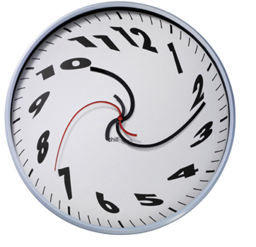
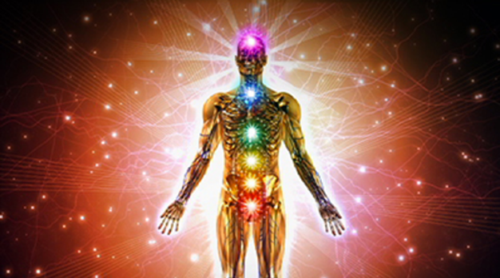
Our Primary Resources
Time
Energy
Generating wealth requires time and energy

Slide 23
How Wealthy Are You?
10
Wealth Potential:
17/40
42.5%
8
4
3
1
2
Material
Wealth
Physical
Health
Emotional
Health
Vitality

Slide 24
How do you become wealthy across the board?
10
1
Material
Wealth
Physical
Health
Emotional
Health
Vitality

Slide 25
The Mistake:
Many people treat this wealth exercise as a zero sum game

Slide 26
Exercise: Increase Your Wealth
Four categories: material, physical health, emotional health and vitality
Score yourself from 1 – 10 in the 4 categories on the Wealth Graph
Calculate your wealth potential percentage
- Add your scores in all 4 categories
- Divide that number by 40
Write down actions you can take to become wealthier in all 4 categories

Slide 27
Ask Yourself…
How can I periodize my work life?
Don’t make the rookie mistake of going hard all the time
How can I increase all the forms of wealth in my life?
So…

Slide 28
What are you waiting for?
Go out and create your own adventure!

